Slide 1


Virtual Machine (HW1) with an Inversed Stack
Presenter: Lan Luo

Slide 2

Outline
Inversed stack
Intuition
Modifications on the code of HW1
Testing on 2 input files

Slide 3
Inversed Stack
Stack in HW1
Inversed Stack
0xff
0xff
bottom
AR2
AR1
main
AR1
AR2
main
BP
SP
top
top
SP
BP
top
GP
* The top boundary of main AR
0x00
0x00
bottom
bottom

Slide 4
Inversed Stack
Stack in HW1
Inversed Stack
FV
SL
DL
RA
Parameters
0xff
AR2
AR1
main
0xff
AR1
AR2
main
BP
SP
SP
Parameters
RA
DL
SL
FV
BP
Parameters
RA
DL
SL
FV
GP
0x00
0x00

Slide 5
Inversed Stack
Stack in HW1
Inversed Stack
0xff
AR3
AR2
AR1
main
0xff
AR1
AR2
AR3
main
N = 4 + #of var,
the length of AR3.
BP
SP’ = SP+N
SP
BP’ = SP-1
BP’ = SP+1
SP
SP’ = SP-N
BP
GP
0x00
0x00

Slide 6

Intuition
Inversed Stack
FV
SL
DL
RA
Parameters
0xff
AR1
AR2
main
BP
SP and BP move inversely;
Changes on stack index should be inversed;
Main is not changed.
iif we are operating main, BP = 0
SP
Parameters
RA
DL
SL
FV
GP
0x00

Slide 7
Modifications
Initialization
Before:
SP = 0; //Stack starts from 0.
BP = 1;
PC = 0;
After:
SP = MAX_STACK_HEIGHT; // Stack starts from 30 in my case
BP = 0;
GP = 0;
PC = 0;
SP = 30
29
29
BP
0
SP
GP = 0
BP = 0

Slide 8
Modifications
INC
Before:
switch(IR.op){
……
case 6:
SP = SP+IR.m;
break;
}
After:
switch(IR.op){
……
case 6:
if (SP-IR.m <= GP) ERROR_StackOverflow();
if (BP == 0) GP = GP+IR.m
else SP = SP-IR.m;
break;
}

Slide 9
Modifications
LOD
Before:
switch(IR.op){
……
case 3:
R[IR.r] = stack[base(IR.l, BP)+IR.m];
break;
}
After:
switch(IR.op){
……
case 3:
if (base(IR.l, BP)==0)
R[IR.r] = stack[base(IR.l, BP)+IR.m];
else
R[IR.r] = stack[base(IR.l, BP)-IR.m];
break;
}

Slide 10
Modifications
STO
Before:
switch(IR.op){
……
case 4:
stack[base(IR.l, BP)+IR.m] = R[IR.r];
break;
}
After:
switch(IR.op){
……
case 4:
if (base(IR.l, BP)==0)
stack[base(IR.l, BP)+IR.m] = R[IR.r];
else
stack[base(IR.l, BP)-IR.m] = R[IR.r];
break;
}

Slide 11
Modifications
CALL
Before:
switch(IR.op){
……
case 5:
stack[SP+1] = 0; // RV
stack[SP+2] = base(IR.l, BP); // SL
stack[SP+3] = BP; // DL
stack[SP+4] = PC; // RA
BP = SP+1;
PC = IR.m;
break;
}
After:
switch(IR.op){
……
case 5:
if (SP-4<=GP) ERROR_StackOverflow(); stack[SP-1] = 0;
stack[SP-2] = base(IR.l, BP);
stack[SP-3] = BP;
stack[SP-4] = PC;
BP = SP-1;
PC = IR.m;
break;
}

Slide 12
Modifications
RTN
Before:
switch(IR.op){
……
case 2:
SP = BP - 1;
BP = stack[SP+3]; // BP = DL
PC = stack[SP+4]; // PC = RA
break;
}
After:
switch(IR.op){
……
case 2:
SP = BP + 1;
BP = stack[SP-3];
PC = stack[SP-4];
break;
}

Slide 13
Modifications
Base()
Before:
// base is the current BP
int base(int l, int base)
{
int b1;
b1 = base;
while (l > 0)
{
b1 = stack[b1 + 1];
// b1 + 1 points to SL
l--;
}
return b1;
}
After:
int base(int l, int base)
{
int b1;
b1 = base;
while (l > 0)
{
b1 = stack[b1 - 1];
// b1 - 1 points to SL
l--;
}
return b1;
}

Slide 14
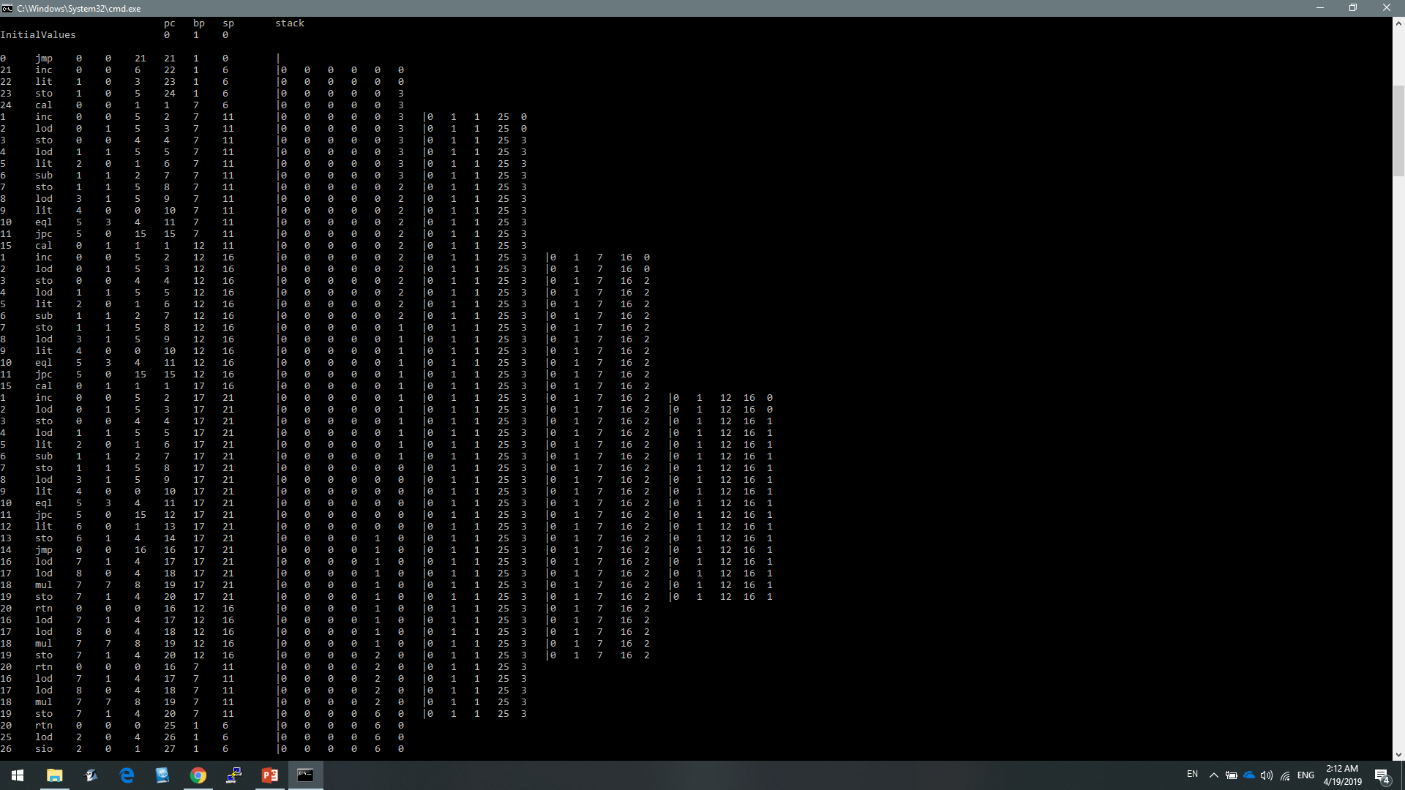
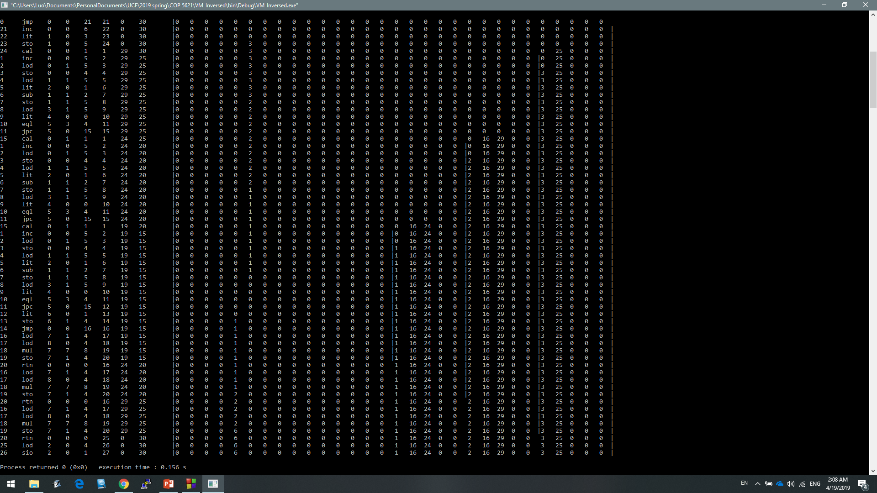
Testing 1

Slide 15
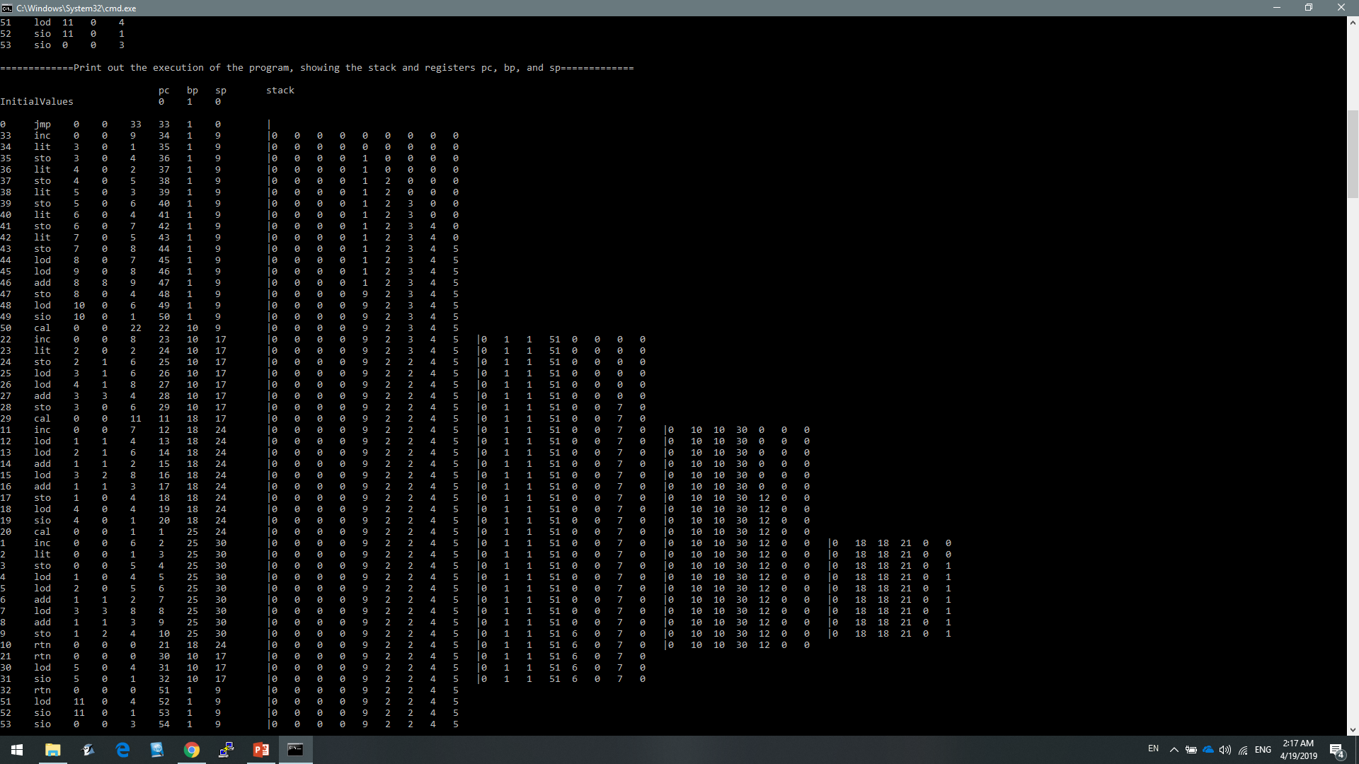
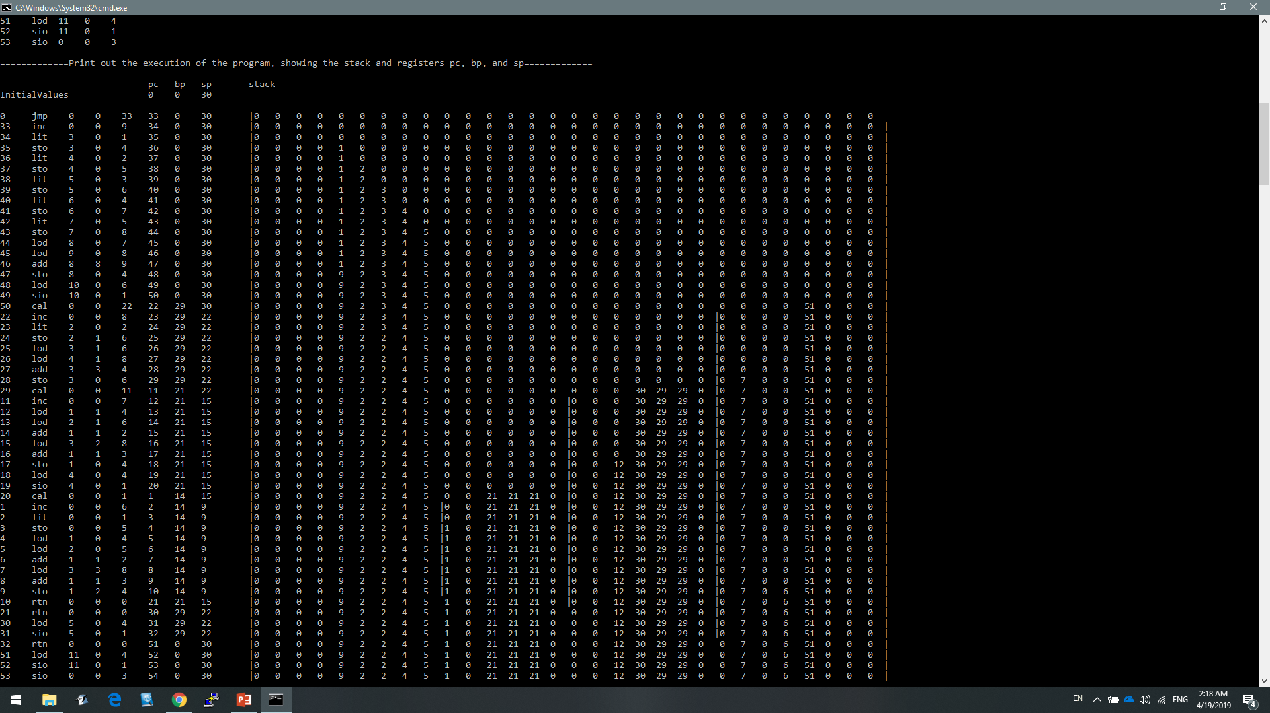
Testing 2

Slide 16

Thank You!

